Slide 1

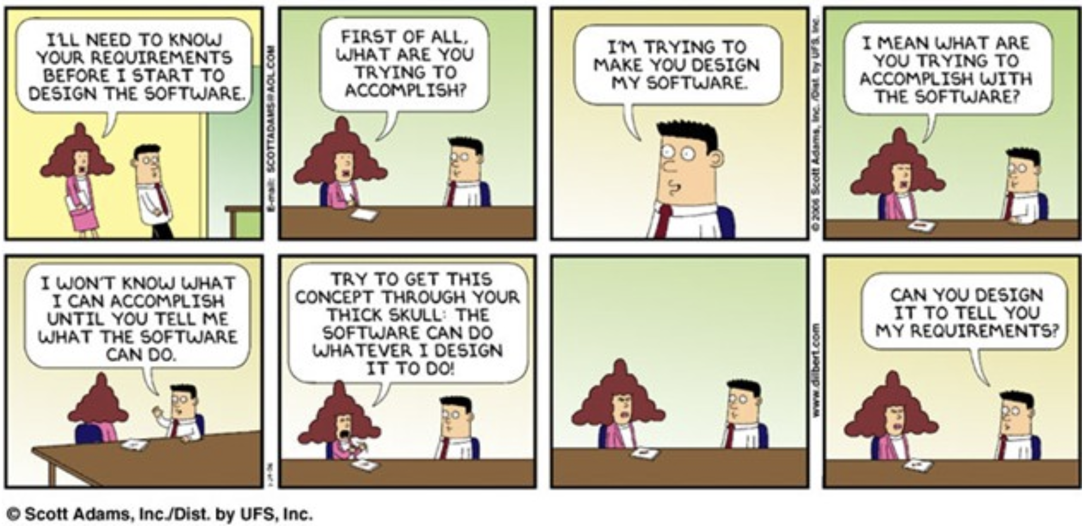

Slide 2
Natural Language Processing (NLP) for Requirements Engineering
Dr. Gouri Deshpande
Postdoctoral Fellow
Dept. of Radiology, Cumming School of Medicine
University of Calgary

Slide 3
Scope
Not to bombard with NLP terminologies
Not to provide an NLP crash course in an hour!
Learning objectives:
To introduce RE related data which is textual in nature
To introduce you to NLP basics
To explain the overall NLP platter that you have for your disposal
To provide a bit of hands-on to kindle your brain with what’s in store and where to get started for your actual work
Goals (Take home message):
Students will get better clarity about NLP in Requirements Engineering domain in general
Feel comfortable working on the tutorials and assignment there after
3
Notes:
Students, most of whom are from Electrical Engineering background, will get better clarity about NLP in Software Engineering domain in general
2) They will feel better equipped to tackle the course project there after

Slide 4
-Plato, 4 B.C
Beginning is the most important part of the work
Requirements Engineering is an early lifecycle process that precedes analysis, design, coding and testing [1]
[1] Bencomo, Nelly, Jin LC Guo, Rachel Harrison, Hans-Martin Heyn, and Tim Menzies. "The Secret to Better AI and Better Software (Is Requirements Engineering)." IEEE Software 39, no. 1 (2021): 105-110.
4

Slide 5
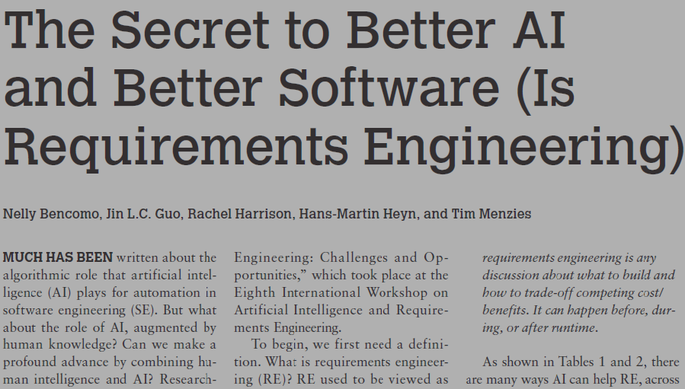
“Requirements engineering is the secret weapon for better AI and better software” [1]
[1] Bencomo, Nelly, Jin LC Guo, Rachel Harrison, Hans-Martin Heyn, and Tim Menzies. "The Secret to Better AI and Better Software (Is Requirements Engineering)." IEEE Software 39, no. 1 (2021): 105-110.
5

Slide 6
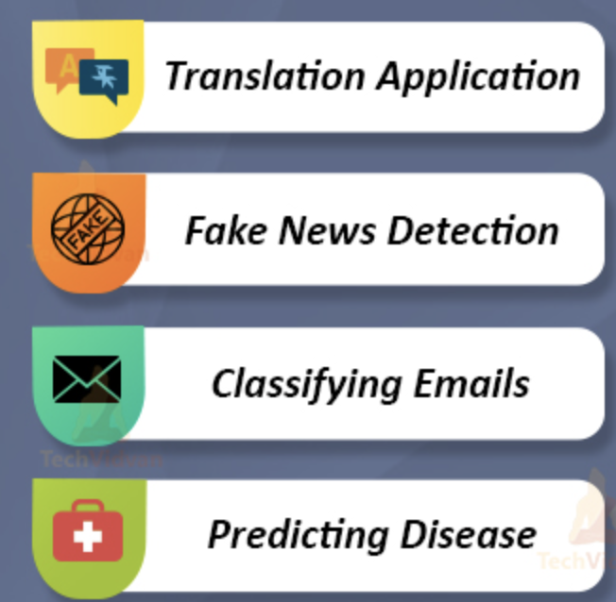
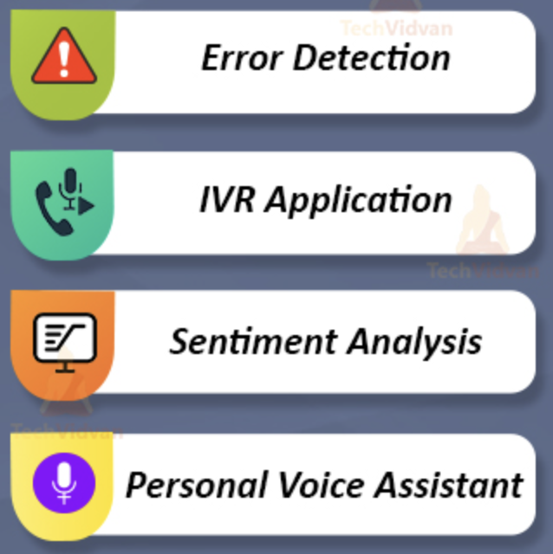
Natural Language Processing (NLP)
1
Introduction
- NLP is a subfield of artificial intelligence that deals with the link between computers and human language.
- NLP involves programming computers to process and analyze a massive amount of natural language data.
Interactive Voice Response (IVR)
Curtsy: https://techvidvan.com/tutorials/natural-language-processing-nlp/
6

Slide 7

Activity
1
Introduction
Please go to -> menti.com
Enter the CODE: 6649 4283
7
Notes:
Search engines
Advanced text editors: Such as Grammarly.com
Computational advertising
Fraud detection
Sentiment analysis
Opinion mining
Text summarization
Context analysis

Slide 8

Activity 2
1
Introduction
What are the various data elements that are textual in nature in any software project?
https://app.mural.co/invitation/mural/teachingseminar2273/1649040320322?sender=u87ddc044b7d44215f90a4726&key=523d2d17-4ca9-45bd-9ad7-b59ae7526a90
8

Slide 9
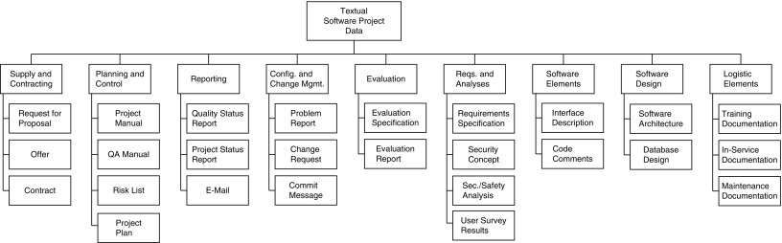
Textual data in Software Project
1
Introduction
2
NLP for RE
Customer review comments
Bird, Christian, Tim Menzies, and Thomas Zimmermann, eds. The art and science of analyzing software data. Elsevier, 2015.
9

Slide 10
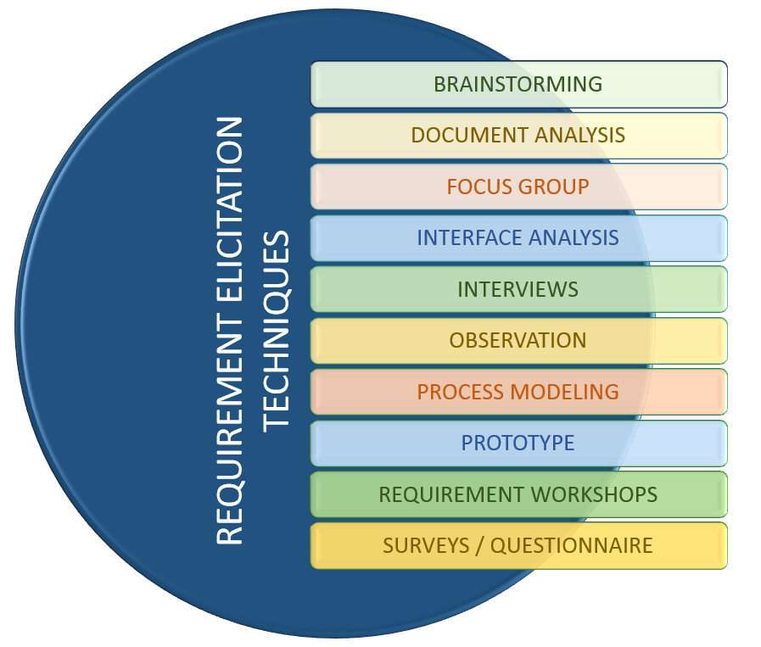
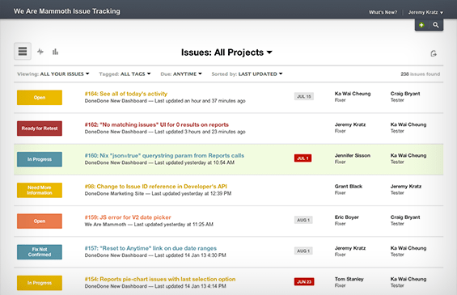


Requirements elicitation
1
Introduction
2
NLP for RE
10
https://systemsplusgroup.blogspot.com/2017/02/requirement-elicitation-techniques.html
Notes:
Requirements elicitation is an excellent example of how things can improve with additional data, in this case in particular with textual data.

Slide 11
The power of data-driven requirements elicitation
1
Introduction
2
NLP for RE
4
Online reviews
Social media
Online discussion/forums
Software repositories
Usage data
Sensor readings
Mailing lists
Identification and classification of requirements-related information
Identification of candidate features related to requirements
Elicitation of requirements
3
Summarization
Clustering
Machine
learning
Analytics
2
Natural Language Processing
5
1
Lim, S., Henriksson, A. and Zdravkovic, J., 2021. Data-driven requirements elicitation: A systematic literature review. SN Computer Science, 2(1), pp.1-35.
11

Slide 12
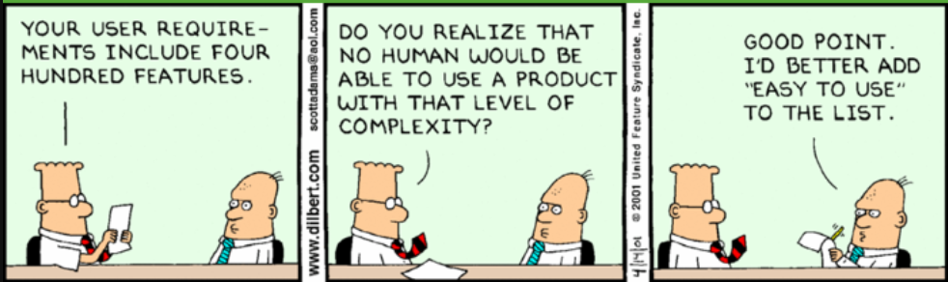
Dilbert on number of requirements
Dilbert (who is the main character here) comic is known for its satirical office humor
12

Slide 13
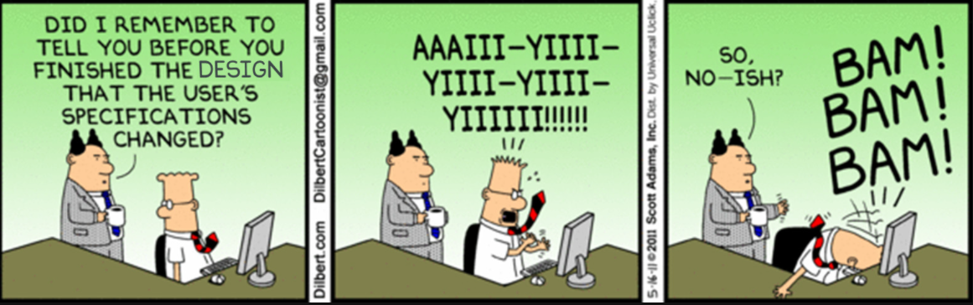
Dilbert on changing requirements
3
NLP based RE tools
13

Slide 14
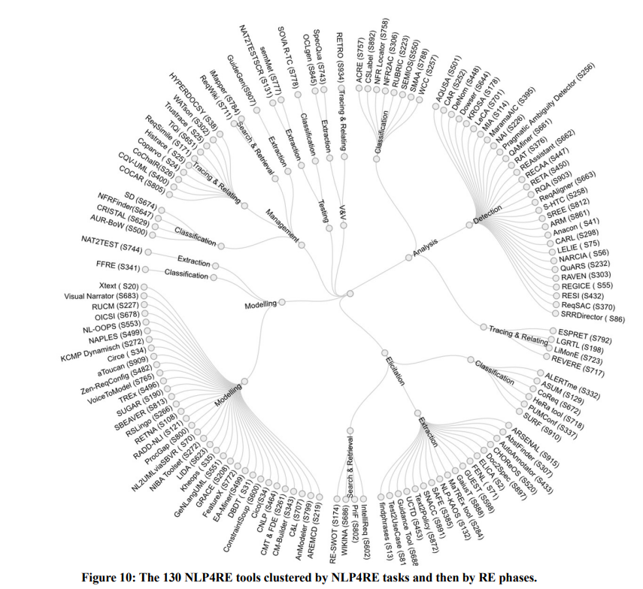
NLP for RE Tools
1
Introduction
2
NLP and ML for RE
3
NLP based RE tools
4
State-of-the-art
Zhao, Liping, et al. "Natural language processing (NLP) for requirements engineering: A systematic mapping study." arXiv preprint arXiv:2004.01099 (2020).
14

Slide 15
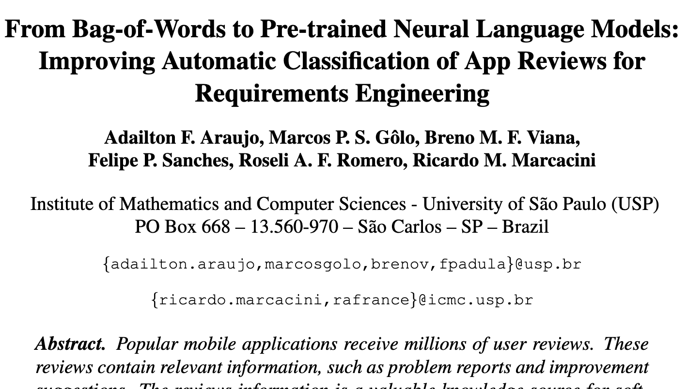

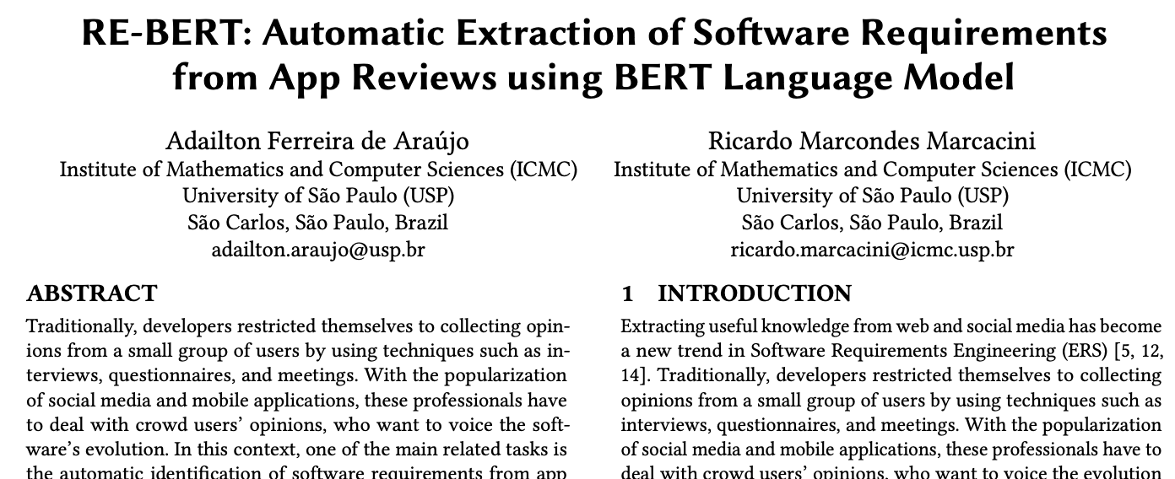
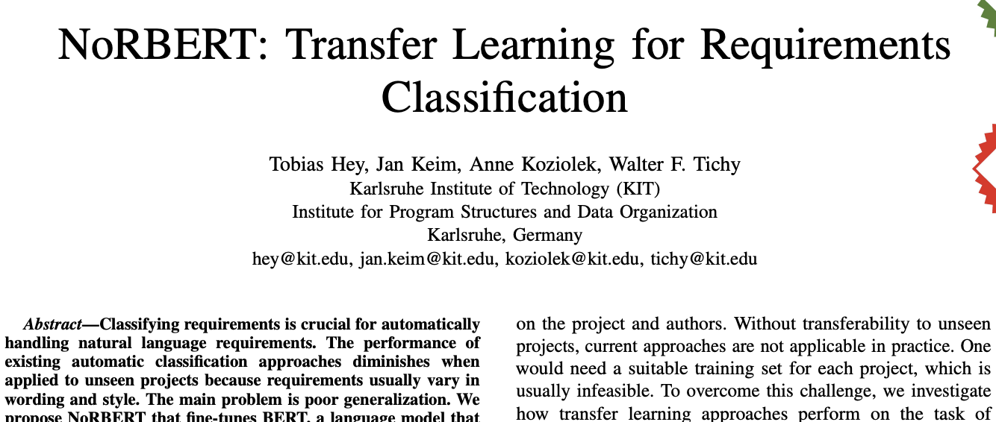
Applications NLP (and ML) in RE: Examples
1
Introduction
2
NLP and ML for RE
3
NLP based RE tools
4
State-of-the-art
5
NLP schema
15

Slide 16
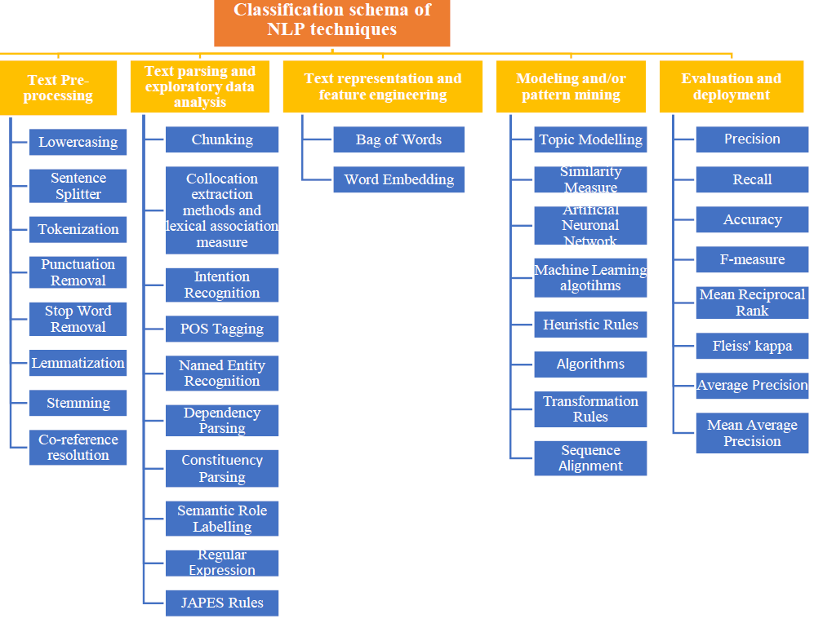
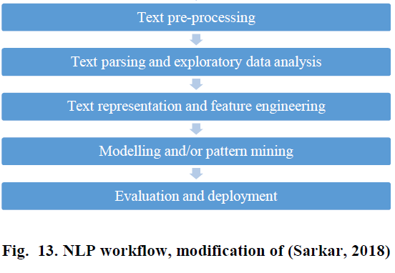
1
Introduction
2
NLP and ML for RE
3
NLP based RE tools
4
State-of-the-art
5
NLP schema
16
Moises Gonzalez-Garcia, Speech recognition, NLP, and the use of ontologies to identify the problem-domain and solution requirements: A systematic mapping study, Information and Software Technology, 2019, In press

Slide 17
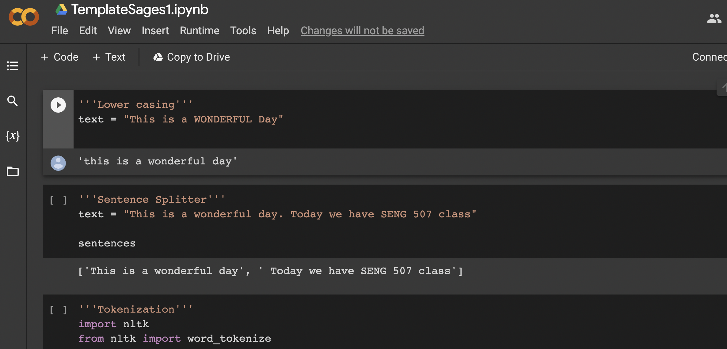
Hands-on
https://colab.research.google.com/drive/1LV6mLwzeHrSD7xgciNpKL9EFw7pePwcV#scrollTo=3ycnR15ZUiqZ&line=1&uniqifier=1
17
Notes:
https://colab.research.google.com/drive/1LV6mLwzeHrSD7xgciNpKL9EFw7pePwcV#scrollTo=3ycnR15ZUiqZ&line=1&uniqifier=1

Slide 18
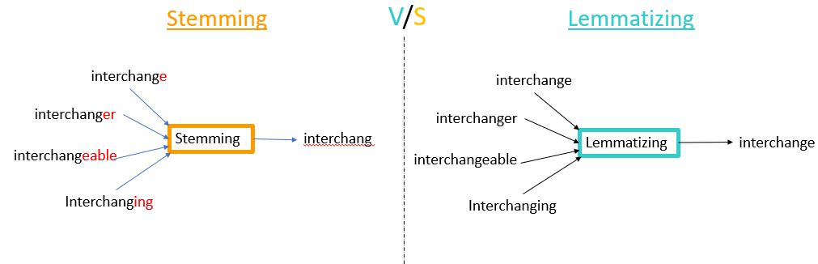
1
Introduction
2
NLP and ML for RE
3
NLP based RE tools
4
State-of-the-art
5
NLP schema
Lemmatization is typically seen as much more informative
18
Moises Gonzalez-Garcia, Speech recognition, NLP, and the use of ontologies to identify the problem-domain and solution requirements: A systematic mapping study, Information and Software Technology, 2019, In press

Slide 19
Lab this week:
Try NLP operations on the App reviews mined from App store:
Link to public data set: https://github.com/amitt001/Android-App-Reviews-Dataset
Curtsy: Grano, Giovanni, et al. "Android apps and user feedback: a dataset for software evolution and quality improvement." Proceedings of the 2nd ACM SIGSOFT international workshop on app market analytics. 2017.
19

Slide 20
Assignment 1:
Individual assignment (6 marks)
Pick one tool from the list of 134 in the paper :
Zhao, Liping, et al. "Natural language processing (NLP) for requirements engineering: A systematic mapping study." arXiv preprint arXiv:2004.01099 (2020).
Extract the following information regarding the tool -
Tool name
Brief description
Purpose
Premises
Goal
Identify and list the NLP Techniques used
Discussion (If any) (bonus 1 mark)
20

Slide 21
Further reading
F. Dalpiaz, A. Ferrari, X. Franch, and C. Palomares. Natural language processing for requirements engineering: The best is yet to come. IEEE Software, 35(5):115-119, 2018.
K. Zamani, D. Zowghi, and C. Arora. Machine learning in requirements engineering: A mapping study. In 2021 IEEE 29th International Requirements Engineering Conference Workshops (REW), pages 116-125. IEEE, 2021.
T. Zimmermann. One size does not fit all. In Perspectives on Data Science for Software Engineering, pages 34-348. Elsevier, 2016.
G. Deshpande, G. Ruhe, and C. Saunders. How much data analytics is enough? the ROI of machine learning classification and its application to requirements dependency classification. arXiv preprint arXiv:2109.14097, 2021.
21

Slide 22




Thank you!
Gouri.Deshpande@ucalgary.ca
Website: pages.cpsc.ucalgary/~gouri.Deshpande
Twitter: @gouriginde
LinkedIn: https://www.linkedin.com/in/deshpandegouri/

